Slide 1

Experiment 1: Real-time score board for a basketball game
Navarro, Rod Geryk C.
CPE161P-4– C1

Slide 2
OBJECTIVES
1. To demonstrate how a score board for a basketball game works in real-time.
2. To be able apply what you have learned in logic circuits and switching theory, microprocessors, and CPE160P.
3. To be able to apply real-time embedded system using Arduino kit.

Slide 3
MATERIALS
Arduino Kit
Buttons/Switches
4-digit Seven Segment Display
LEDs
Laptop

Slide 4
PROCEDURE
Create a working real-time score board using Arduino.
To demonstrate the usage of 4-digit seven segment display and buttons.
Debug the code

Slide 5
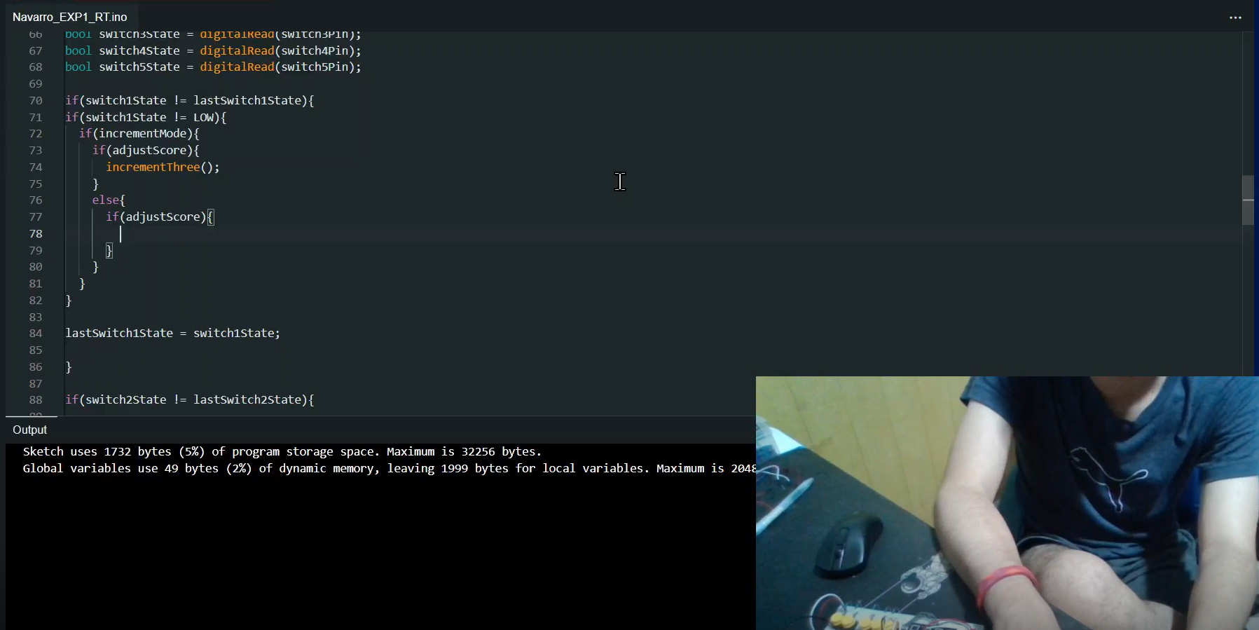
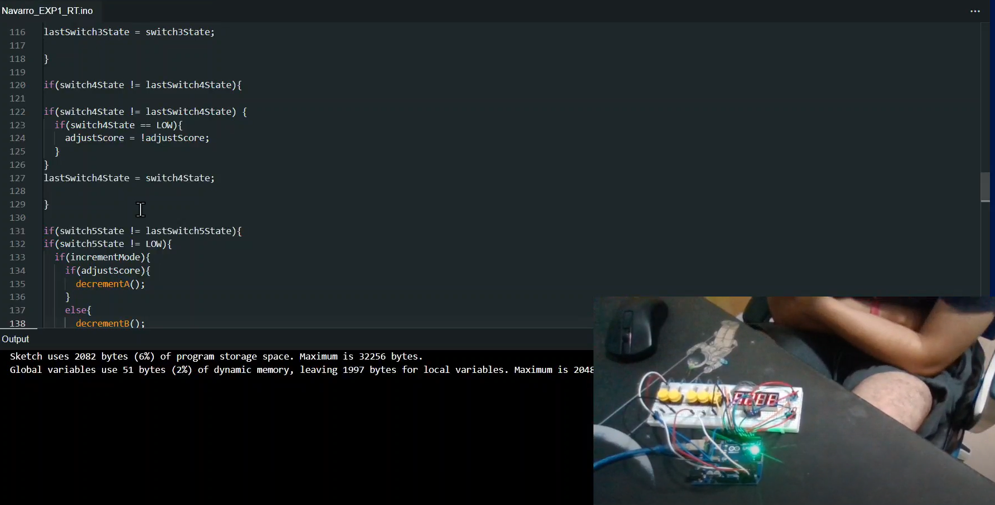
PROCEDURE

Slide 6
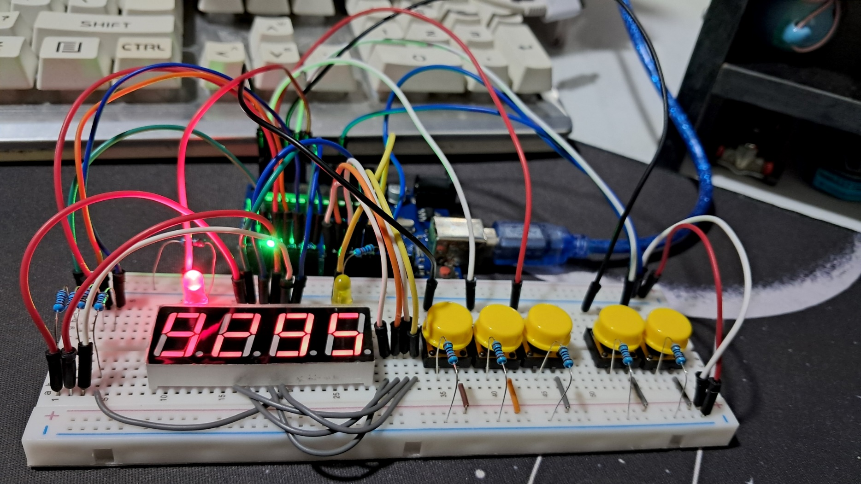
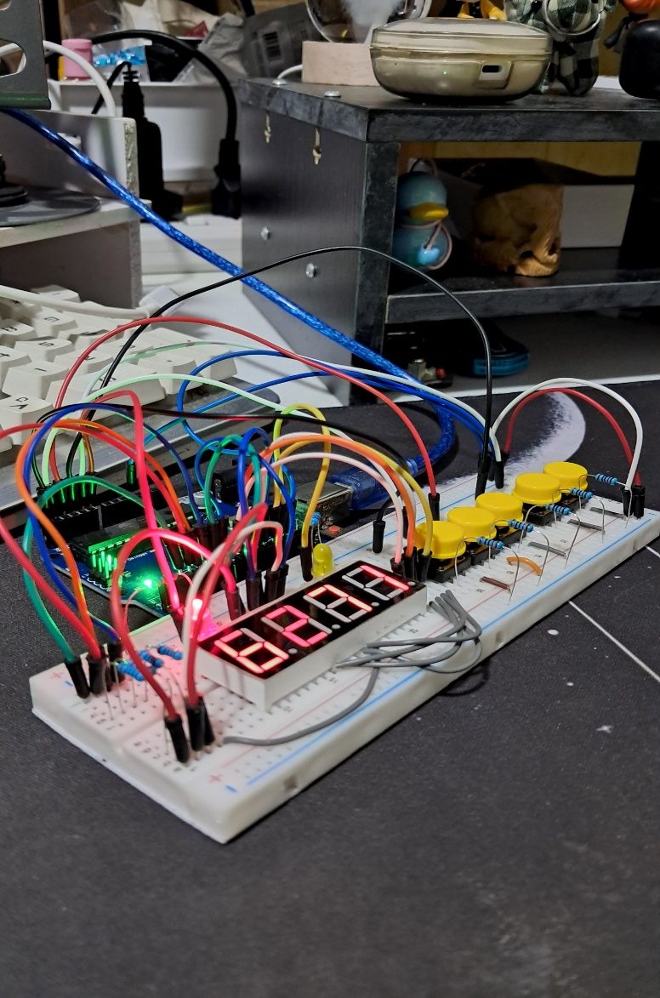
Final Output

Slide 7
THANK YOU!

